Slide 1
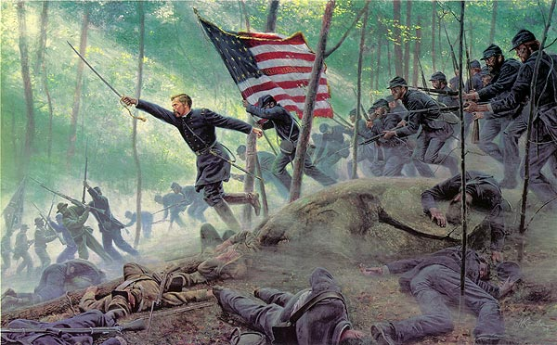
July 2, 1863 Little Round Top, Gettysburg
Col. Joshua Chamberlain
Hold your position “at all costs”

Slide 2
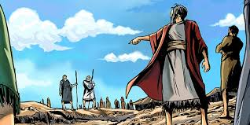
Conflict with God: Korah
NUMBERS 16

Slide 3
CONFLICT
Resolution
Meeting
Theme:
Fri: 5 Reasons to Embrace Conflict
Sat: Conflict with God
Sun: Conflict with Brethren
Sun: Conflict with Self
Sun: Conflict with Family

Slide 4
BIBLICAL Definition
GREEK
agōnízomai, G75, “to fight,
wrestle… straining every
nerve towards the goal…
pains and toil”

Slide 5
epi-agōnízomai

Slide 6
Conflict
with God
The Rebellion of Korah
The Censer of Korah
The Sons of Korah

Slide 7
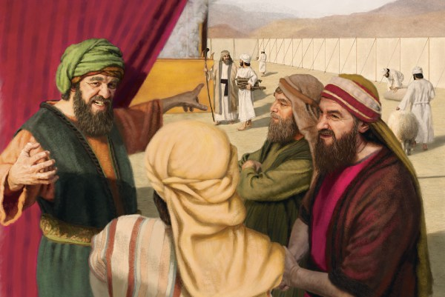
#1
The Rebellion of Korah

Slide 8
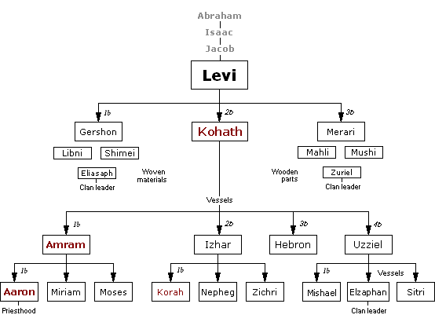
The Genealogy of Korah

Slide 9
The Duties of the Kohathites

Slide 10
#1
The Rebellion of Korah
Those in Conflict with God:
Sin
Stir
Slander

Slide 11
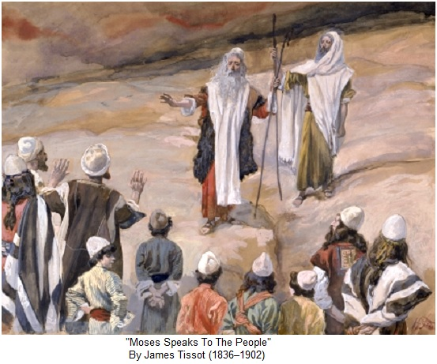

Slide 12
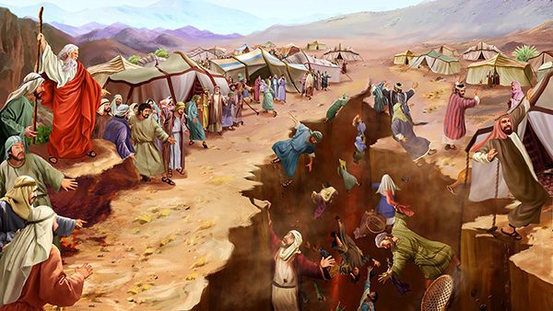

Slide 13
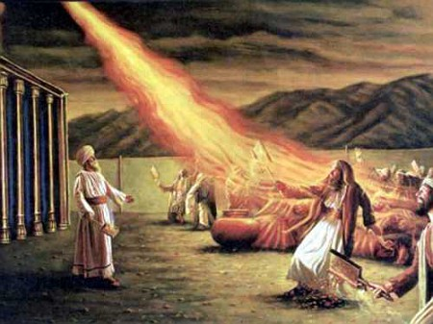
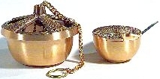
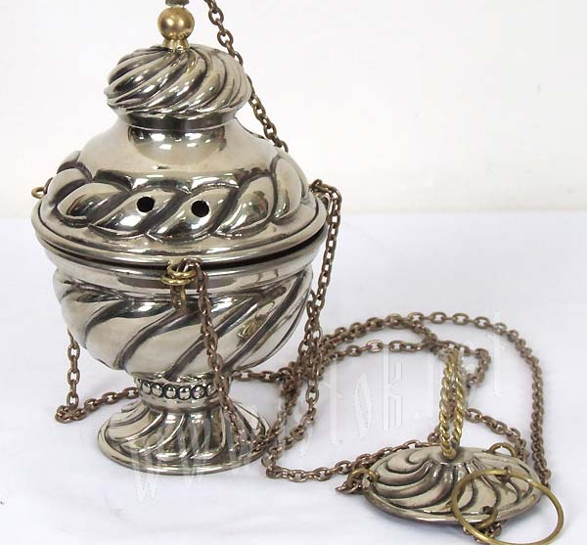
#2
The CENSER of Korah

Slide 14
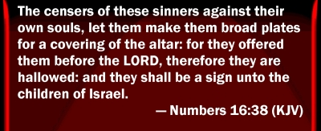
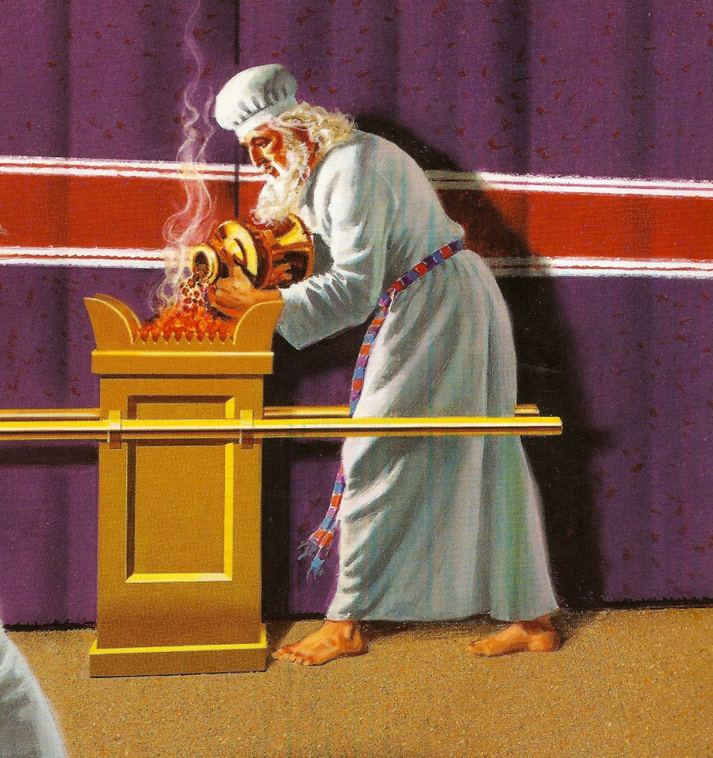
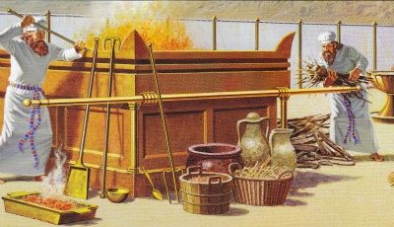

Slide 15
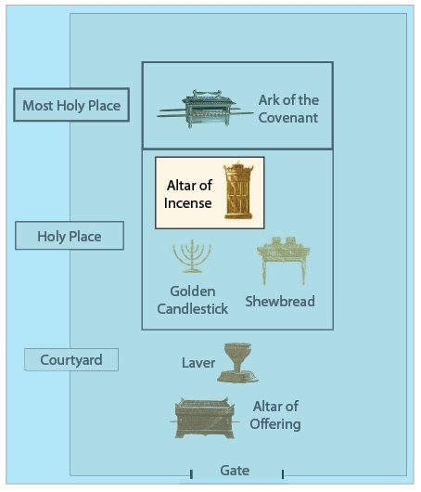

Slide 16
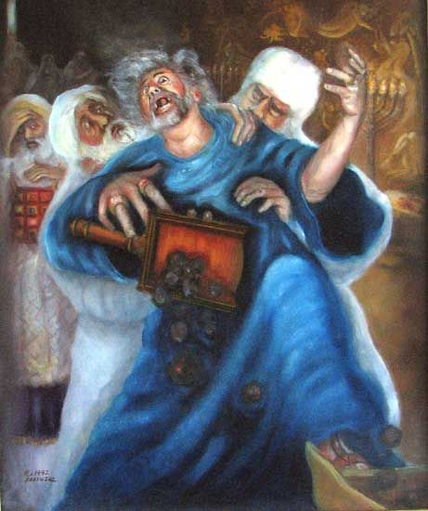
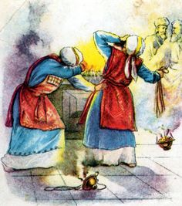
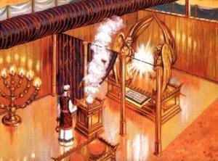
King Uzziah
Nadab
& Abihu
Day of Atonement

Slide 17
#2
The Censer
of Korah
Compels us to:
Sumbit
Stir
Serve

Slide 18
#3
The SONS of Korah
?

Slide 19
#3
The SONS of Korah
Demonstrate what it means to walk in
PEACE with God

Slide 20
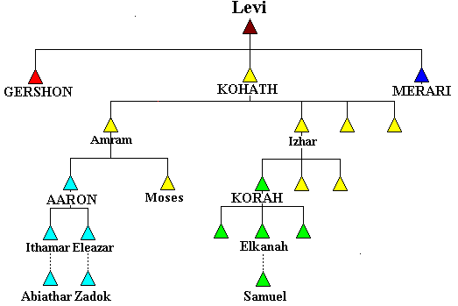
The SONS
of Korah
SAMUEL
1 Chron. 6:22-27

Slide 21
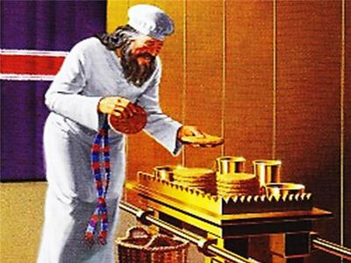
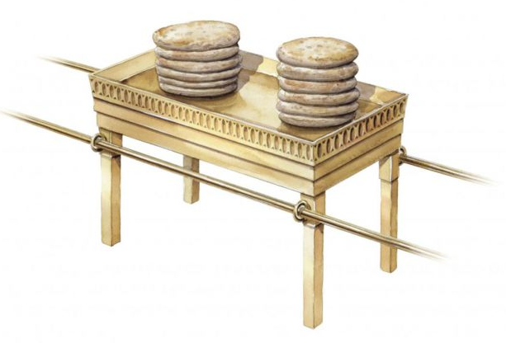
Descendants of Korah made SHOWBREAD
1 Chron. 9:31-32

Slide 22
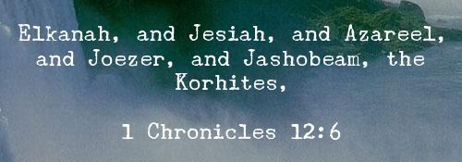
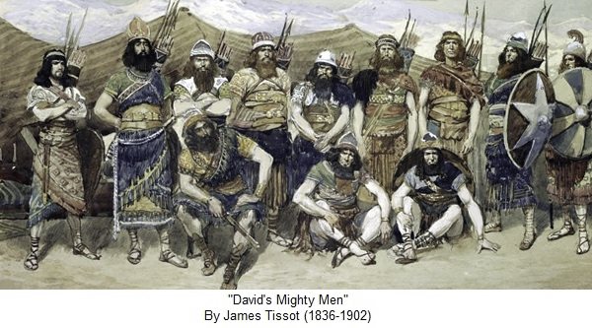
The SONS
of Korah
David’s
Mighty
Men
1 Chr. 12:1,6

Slide 23
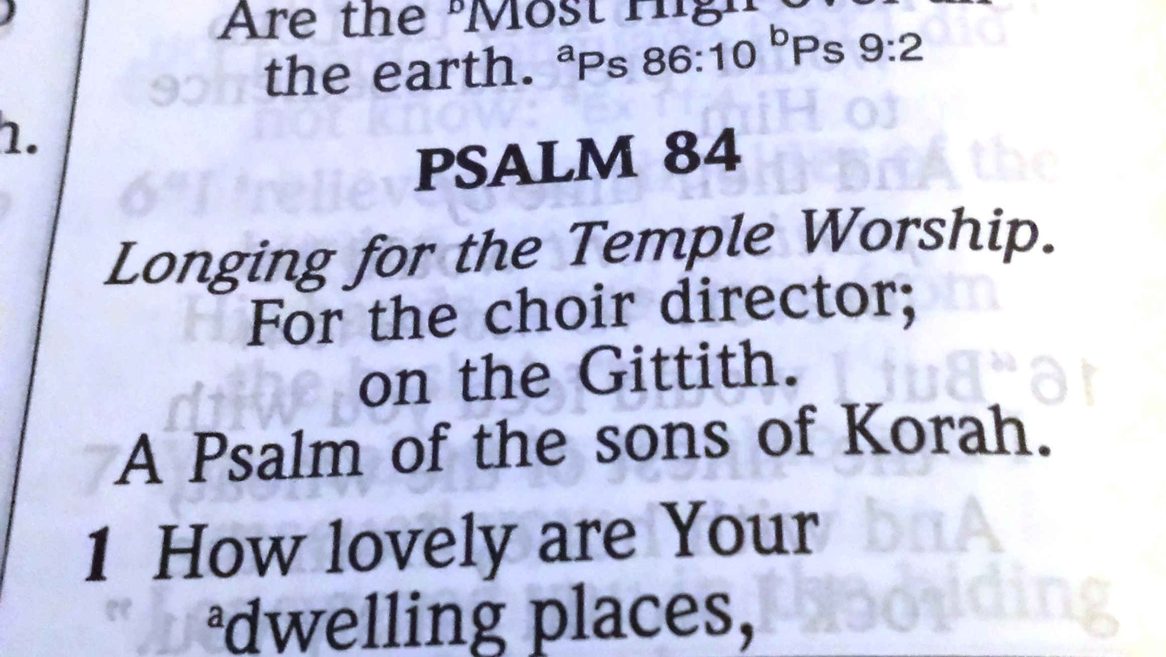
The SONS of Korah
Heman the singer, son of Joel, son of Samuel...of Korah 1 Chron. 6:31-38
Writers of 11 Psalms
42,44,45,46,47,48,49,84,85,87,88

Slide 26
Conflict
with God
The Rebellion of Korah
The Censor of Korah
The Sons of Korah

Slide 27
We have ALL been like sinful KORAH

Slide 28
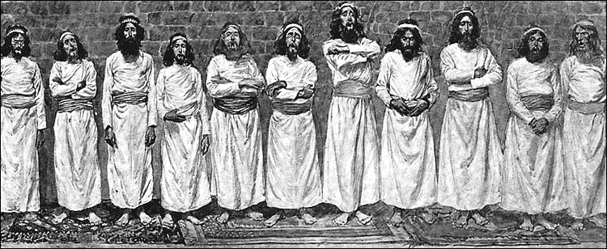
But, we can all be faithful like the Sons of KORAH

Slide 29
Joshua Chamberlain
June 19, 1864, Battle of Petersburg
My darling wife,
I am lying mortally wounded the doctors think, but my mind and heart are at peace. Christ is my all-sufficient Savior. I go to him. God bless & keep & comfort you, precious one. You have been a precious wife to me. To know & love you makes life & death beautiful. Cherish the darlings & give my love to all the dear ones. Do not grieve too much for me. We shall all soon meet. Live for the children. Give my dearest love to Father, Mother & Sallie & John. Oh how happy to feel yourself forgiven God bless you evermore precious, precious one.
Forever yours, Lawrence
Letter written to his wife after being wounded. (June 1864), as quoted in In the Hands of Providence : Joshua L. Chamberlain and the American Civil War (2001) by Alice Rains Trulock, p. 215

